Slide 2
" In The Name of Allah, The Most Beneficent, The Most Merciful" Challenges facing the real Halal With focus on Halal standards and Halal accreditation agencies How Important is real Halal to You? By: Dr. Hani M. Al-Mazeedi

Slide 3
The consumer has the right to know
من حق المستهلك أن يعرف
And deliberately consumers are made not to know
ويتم عمداً جعل المستهلك لا يعرف

Slide 4
Scope
This presentation tackles some of the challenges that, in one way or another, proves that the current international activities in Halal are not achieving requirements of the real Halal¹, requirements of Halal standards² or requirements of Halal accreditation agencies³.
© Halal Sciences Academy Limited

Slide 5
Content
Introduction
Challenges minimizes the effectiveness of the real Halal
How to correct these challenges?
Challenges minimizes the effectiveness of meeting requirements of Halal standards and of Halal accreditation agencies
How to correct these challenges?
Conclusions
Recommendations
© Halal Sciences Academy Limited

Slide 6
Introduction
In almost all countries, Halal is a religious issue. Hence, the state will not intervene;
At most, Halal is regulated under the labeling law;
Halal certification, therefore, is conducted by many agencies/ associations/ councils/ federations, etc.; based on trust and without any type of control, and
So far no unified Halal standard and its associated logo exist.
© Halal Sciences Academy Limited

Slide 7
Introduction
The Halal market is global, but Halal is interpreted differently in different countries
Negative perception of Halal / Islam-o-phobia is still a challenge in non Muslim countries.
The general public, decision makers, religious Ifta committees, food scientists & technologies are not sensitive enough to Halal matters.
© Halal Sciences Academy Limited

Slide 8
1
2
3
4
Lack of Halal awareness
Doubts in Halal standards
Lack of alternative Halal ingredients
Lack of
Halal laboratories
11 Challenges
5
6
7
8
Ifta agencies are less qualified to deliver religious Fatwa on emergence issues in Halal
Halal logos sometimes are not welcomed
Halal markets owned by non-Muslims
Muslim governments are confident falsely with their Halal control
© Halal Sciences Academy Limited

Slide 9
9
10
Unnecessary high belling invoices by Halal accreditation agencies
Absence of effective control over accredited Halal Certification Bodies, HCB
Challenges
11
Interference of western government agencies aiming to degrade Halal requirements to a level that suit their meat industry
© Halal Sciences Academy Limited

Slide 10
Let us go over these challenges and see how they can be corrected

Slide 11
1. Lack of Halal awareness
The understanding of ‘Halal’¹ or ‘what is Halal’ ² or ‘what the Halal logo mean’ ³ is confusing among many Muslim consumers, causing misunderstanding and even fraud by certain individuals and bogusكاذبة associations “selling” Halal certificates*.
*(ASIDCOM research)
© Halal Sciences Academy Limited

Slide 12
Where is the problem?
Absence of Halal awareness on a wide scale among consumers, Muftis, and Halal control agencies especially when it comes to hiding ingredients المكونات الخفية , and emerging issues النوازل.
Existence of disputable religious Fatwas on Halal.
Maneuvering of Halal stakeholders around disputable religious issues on Halal.
Exploitationإستغلال of Halal stakeholders on consumer’s ignorance on Halal.
© Halal Sciences Academy Limited

Slide 13
How to correct this challenge?
Halal definitions must be unified¹, become so clear², explicitصريحة ³, and practiced stringently⁴ by Halal stakeholders.
Dedicated government initiatives to establish Halal education, and assess Halal Awareness to all of its institutions.
Muftis should be educated on Halal and make them speak as one voice of what is the real Halal.
© Halal Sciences Academy Limited

Slide 14
How to correct this challenge?
Religious fatwas related to Halal must be unified in line with what is currently happening in slaughterhouses and processing plants so that it read this way:
Free from stunning
Free from mechanical slaughtering
Free from Alcohol
Free from non-Muslim slaughter men
Free from Haram Najis ingredients or Istihala*.
Collectively these 5F commands of Halal I called them:
*As a mean of looking at Haram Najis ingredients as Halal based on the assumption of transformation or consumption theory.
5F
© Halal Sciences Academy Limited

Slide 15
2. Doubts in Halal standards
International Halal standards, or so called Halal standards, many of which have pitfalls, i.e. allowing non-Halal practices¹, and non-Halal ingredients² to penetrate into the markets under legal frame.
© Halal Sciences Academy Limited

Slide 16
Where is the problem?
Is what we read in these standards, for example:
Halal slaughtering is best done without stunning, however, if necessary, stunning can be used!
Stunning is not acceptable but mechanical slaughtering is acceptable! How can that be? You can not mechanically slaughter without stunning.
Ethyl alcohol produced by fermentation is not allowed, however, if produced synthetically it is allowed! What is the difference between the two? And which type of alcohol is commercially available on a wide scale.
© Halal Sciences Academy Limited

Slide 17
Where is the problem?
Finally, the presence of Najis materials is not allowed, however, if present in minute amounts, such as enzymes, this is called: a form of transformation or subjected to the theory of consumption, i.e. Istihala إستحالة, then what follows that there presence is allowed!
© Halal Sciences Academy Limited

Slide 18
How to correct this challenge?
We should look at Halal standards as guidelines rather than Fatwa! This way disputable religious issues will be minimized.
We should stick with unanimous religious Fatwas of prominent scholars on Halal issues rather than the exceptional religious view of a single prominent scholar.
© Halal Sciences Academy Limited

Slide 19
3. Lack of Halal laboratories
The lack of Halal laboratories is a universal challenge to the real Halal.
The importance of these laboratories is to provide necessary technical supports to strengthen Halal certification Services.
© Halal Sciences Academy Limited

Slide 20
Where is the problem?
The rare availability of accredited Halal laboratories.
The rare availability of qualified Muslim technicians to run Halal analyses, is another big challenge to the real Halal.
The lack of approved Halal analysis protocols is an obstacle, and this is important as well for the unification of Halal analysis results.
© Halal Sciences Academy Limited

Slide 21
How to correct this challenge?
Accrediting Halal laboratories.
Qualifying Muslim Halal analysts.
Making Halal analysis protocols not monopolized by leading Halal R&D centers like Putra University of Malaysia and make them patented-free to be used worldwide, especially by laboratories in Muslim countries.
© Halal Sciences Academy Limited

Slide 22
4. Lack of alternative Halal ingredients
The lack of alternative Halal ingredients will lead to lack of Halal products.
Examples of alternative Halal ingredients:
Fat, glycerin, and salts of fatty acids –< Halal & vegetable sources
Protein concentrate (whey), amino acids, and gelatin –< Halal & vegetable gelling agents sources
Enzymes –< Halal sources
Alcohol for external use –< isopropyl
© Halal Sciences Academy Limited

Slide 23
Where is the problem?
Alternative Halal ingredients are not requested or encouraged to be produced.
Alternative Halal ingredients do not have a strong market.
Governments do not care to request alternative Halal ingredients in imported or locally produced products.
Importers as will as consumers do not bother to ask for alternative Halal ingredients.
© Halal Sciences Academy Limited

Slide 24
How to correct this challenge?
Promote Halal awareness among manufacturers, government agencies, and consumers to request alternative ingredients from Halal sources.
Governments should encourage¹ and interfere² to impose فرض³ the use of alternative ingredients from Halal sources in food and non-food products.
© Halal Sciences Academy Limited

Slide 25
5. Halal logos sometimes are not welcomed
Halal logos sometimes are not welcomed on certain products like cosmetics! This is because of the belief that the presence of Halal logo on these products will degrade their values.
Many do not know that Halal logos are not just symbols of guarantee for Muslims that what they’re buying is allowed by their religion, but also for businesses looking to expand to reach Muslim countries and beyond.
They also do not know that Halal logos have now become a symbol of quality and religious compliance and this makes it sound as the new green.
© Halal Sciences Academy Limited

Slide 26
Where is the problem?
The existence of non trustworthy Halal certification bodies.
The absence of Halal regulations that require Halal logos on food and non-food items imported to Muslim countries.
The lack of Halal awareness on the value of having Halal logo on Halal products.
© Halal Sciences Academy Limited

Slide 27
How to correct this challenge?
Establish Halal awareness.
Provide results from sound techno-economic studies on the profitability of putting Halal logo on products.
Establishing a regulation on the compulsory use of Halal logo on Halal products.
© Halal Sciences Academy Limited

Slide 28
6. Halal products are in the hand of non-Muslims
Most of the so called international Halal products are in the hand of non-Muslims.
In the year 2009, McDonald’s in Singapore has seen an influx of eight million customers a year after obtaining a Halal certification.
Since being certified Halal, KFC, Burger King and Taco Bell have all seen an increase of 20 per cent in customers
© Halal Sciences Academy Limited

Slide 29
Where is the problem?
How one can be sure 100% with no doubts, in courtiers other than Malaysia*, that famous food brands owned by non-Muslims are complied with the requirements of the real Halal?
What is the companies’ definition of Halal?
How is Halal is being controlled by these companies? And by Whom?
Most of these non-Muslim International food and non-food companies uses stunning, or alcohols, or even Najis materials present in minute amounts in their products. They announced it loudly on their websites, but no one read.
*The Department of Islamic Development (Jakim), state religious departments (JAIN), and state Islamic councils (MAIN)
© Halal Sciences Academy Limited

Slide 30
How to correct this challenge?
Increase the awareness of Muslim consumers of the view of Halal by non-Muslim and by local government regulations.
Muslim governments must interfere to request the real Halal on imported products.
Only approved accredited Halal Certification Bodies should certify international Halal products as Halal.
© Halal Sciences Academy Limited

Slide 31
7. Muslim governments are falsely too confident with their Halal control
Muslim governments are too confident with their Halal control agencies that in reality are too ignorance of what the real Halal is or how to control it.
Being a member of Halal committees, or attending Halal conferences or Halal trainings courses will not make some one expert on Halal, and individuals should investigate and search for what is the real Halal.
© Halal Sciences Academy Limited

Slide 32
Where is the problem?
Government control agencies have little information on what products (food and non-food) should be analyzed for Halal, what ingredients should be under question, and what protocol to follow in laboratory for Halal analysis.
One always hear: we have good Halal control¹, every thing is fine², (Mafee Mushkelah) or we do not need help³.
© Halal Sciences Academy Limited

Slide 33
How to correct this challenge?
Increase awareness of the real Halal among Halal control agencies.
Collaborate with international Halal certification bodies to control Halal in Muslim countries to name but few: HFFIA and Halal correct of Holland, HMC, EHDA, and Halal Assurance of UK, Halal control of Germany, and Halal Verif, AVS, Halal service and WMCO/ASIDCOM of France, IFANCA of USA, and GIMDES from Turkey.
© Halal Sciences Academy Limited

Slide 34
8. Ifta agencies are less qualified to deliver religious Fatwas on Halal
Few international conferences and workshops on the permissibility of the consumption or the use of certain practices in productions of Halal products, or the use of non Halal ingredients in food and non-food items has shown that they approve the deliberate manipulation of Haram practices or acts on Haram ingredients to make them Halal.
© Halal Sciences Academy Limited

Slide 35
Where is the problem?
Official Ifta agencies have shown to be less qualified to deliver religious Fatwas on emerging contemporary issues on Halal like stunning¹, mechanical slaughtering², presence of alcohol³, and have disputable stand on what is or what is not a transformed material from Najis sources⁴.
Individual sheikhs (i.e. religious figures) some times give wrong Fatwas on Halal and such fatwas spread around with the speed of light.
People listen only from religious figures even if they are less qualified to speak on Halal issues.
© Halal Sciences Academy Limited

Slide 36
How to correct this challenge?
Must have fully dedicated Halal Ifta agency that is experts with emerging contemporary issues on Halal.
Individual religious figures should be educated on what is the real Halal.
© Halal Sciences Academy Limited

Slide 37
9. Un necessary high belling invoices by Halal accreditation agencies
Although some Halal accreditation agencies' belling invoices compared to belling invoices of other Halal accreditation agencies is some what lower, their belling invoices are still too high.
Some of the expenses that are forced to be covered to Halal accreditation agencies are: 1) business class travelling tickets; 2) accommodation in five start hotel.
© Halal Sciences Academy Limited

Slide 38
9. Un necessary high belling invoices by Halal accreditation agencies
Some times HCB are forced to pay Shubha/Haram money to some Halal accreditation officers (personal communications).
And in some other times, a member of a Halal accreditation agency visits a single country for a number of Halal certification bodies and requests cash money from each for the cost of the business class and surprisingly he comes on an economy class.
© Halal Sciences Academy Limited

Slide 39
Where is the problem?
Despite the eagerness رغبه قويه and their good intentions in servicing Halal, Halal accreditation agencies are financially burdening HCB to fulfill a noble cause.
HCB are welling to coupe with all financial requirements of any Halal accreditation agency but this will be on the expenses of assuring the real Halal.
When money is involve in achieving the real Halal their will be concessions somewhere down the stream within the Halal chain that may jeopardize achieving the real Halal.
Halal accreditation agencies being emerging from governmental bodies should not be involved in Halal business or looked at Halal as a way of generating money.
© Halal Sciences Academy Limited

Slide 40
How to correct this challenge?
Halal accreditation agency must give up their initial high belling invoice to HCB, they should also refrain from acting as a halal certification body, as this is happening that an accreditation agency act both as a judge and as certifier.
The high belling invoice by Halal accreditation agencies must be reduced to minimum, especially when it comes to unnecessary expenses items.
© Halal Sciences Academy Limited

Slide 41
10. Absence of effective control over accredited HCB
Accredited Halal certification bodies are not Halal controlled at all, e.g. religious mistakes in Halal that are committed before by HCB after being accredited are continued to be practiced (e.g. use of mushroom gun that lead to death, stunning of chickens, etc.,).
What accreditation process seamed to be is a quality management system that deals with documents¹ and records² more than fulfilling requirements of the real Halal or at least International Halal standards.
© Halal Sciences Academy Limited

Slide 42
Where is the problem?
Accreditation agencies are more oriented to be a quality management system rather than Halal. Reorientation of the accreditation process must take place in such a way to focus mainly on Halal.
Accreditation processes in Halal is a challenge to accreditation agencies that must involve also religious scholars and muftis in which at present non are involved.
© Halal Sciences Academy Limited

Slide 43
How to correct this challenge?
Halal accreditation processes must be reviewed and should be looked at as it is the task of religious scholars rather than the a job of the normal routine activities of accreditation officers.
© Halal Sciences Academy Limited

Slide 44
11. Interference of western government’s agencies to degrade Halal requirements to a level that suit their meat industry
Western governments have tried in so many ways to dilute the effect of HCB to minimum under the excuses of legislation, animal welfare, and socio-economic issues for examples:
Ministry of Primary industry of Australia (1983)
DIALREL (Dialogue on the religious slaughter)
ONR (Austria normalization organization)
AFNOR (French association for normalization)
CEN (Committee for European normalization)
BECI (Brussels House for trade and companies)
© Halal Sciences Academy Limited

Slide 45
Where is the problem?
Halal standards are not fully implemented
Halal religiously is endangered when it is under the control of non-Muslims
© Halal Sciences Academy Limited

Slide 46
How to correct this challenge?
Muslim governments through their ministry of foreign affairs should send a clear message to the meat industries in exporting countries that:
Halal is a religious issue that must be fully and only controlled by Muslim HCB.
Halal standards must be fully respected and fully implemented.
© Halal Sciences Academy Limited

Slide 47
Conclusion
The real Halal can only be achieved by going strict Halal.
Halal awareness is the key to solve many Halal issues.
Alternatives to Haram can be provided in robust amounts.
Under normal circumstances, Haram materials are not allowed to be used for any purpose.
Orders of Allah almighty delivered to us to implement them and not for maneuvering around them.
Accredited Halal certification bodies are not under control of Halal accreditation bodies.
Halal accreditation bodies are involved in Halal businesswise.
© Halal Sciences Academy Limited

Slide 48
Recommendations
Assessment of Halal Awareness must be conducted routinely.
Halal awareness programs must be established at early educations.
Muslim consumers should be educated on Halal terminologies and what do they imply in their daily life.
Muslim consumers should not rely totally in Halal on their governmental control agencies; they must depend on themselves by questioning before buy.
Governments should request from international companies to provide the real Halal on food and non-food items.
© Halal Sciences Academy Limited

Slide 49
Recommendations
Muslim scholars should unite with one opinion on Halal and Haram on emerging issues.
Accreditation agencies must reorient themselves to focus mainly on Halal rather than solely on the requirements of quality management systems.
Finally, government bodies concerned in pursuing halal should establish a deterrent punishments عقوبات رادعة to anyone who begs يسول himself by passing transactions for uncertified Halal shipments.
© Halal Sciences Academy Limited

Slide 50
References
*This article was originally written in Arabic and taken from the book “My Food, under review for 2017”, by its author Dr. Hani Mansour Mosa Al-Mazeedi. Kuwait Institute for Scientific Research. References for this articles are found in the book My Food.
© Halal Sciences Academy Limited

Slide 51
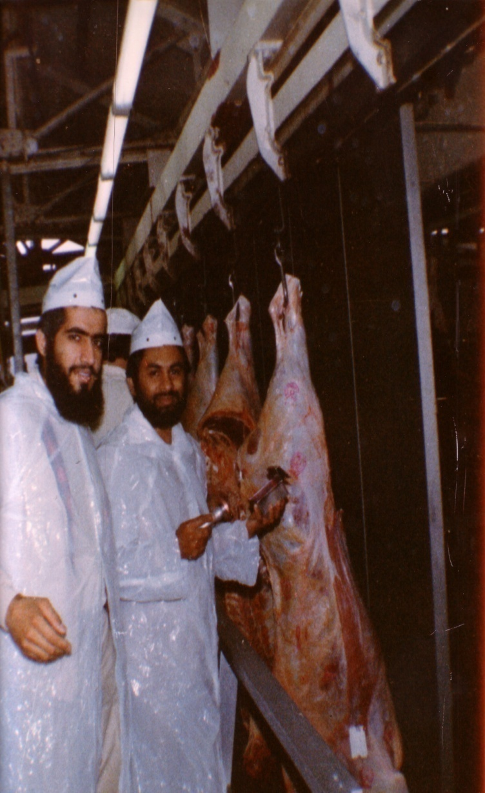
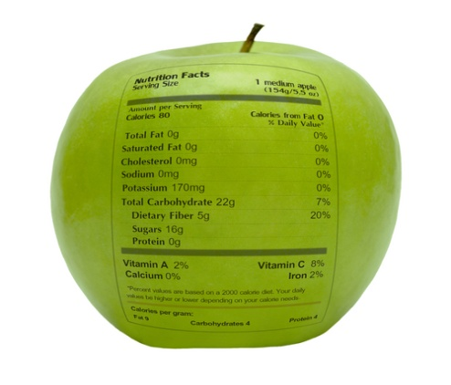
شكراً لاستماعكم
سبحنك اللهم وبحمدك أشهد أن لا إله إلا أنت، أستغفرك وأتوب إليك
mazeedi@hotmail.com
0096597498500
د. هاني منصور المزيدي
مع الأخ أمجد محبوب في أستراليا سنة 1981
Dr. Hani Mansour Al-Mazeedi
With brother Amjad Mahboob in Australia in 1981

Slide 52
www.HalalSciencesAcademy.com
Trademarks, icons, images belong to their respective owners.
© Halal Sciences Academy Limited

